Slide 1


Data Science Capstone Presentation
Author: Deen Huang

Slide 2
Introduction
This project is created to classify and predict the credible credit card clients based on the classic and advanced machine learning methods
The idea is to use the default of credit card clients data set from UCI Machine Learning applied in different machine learning models and compared the performance of two models

Slide 3

Dataset
Default of Credit Card Clients Data Set:
https://archive.ics.uci.edu/ml/datasets/default+of+credit+card+clients

Slide 4
Dataset
ID: ID of each client
LIMIT_BAL: Amount of given credit in NT dollars (includes individual and family/supplementary credit
SEX: Gender (1=male, 2=female)
EDUCATION: (1=graduate school, 2=university, 3=high school, 4=others, 5=unknown, 6=unknown)
MARRIAGE: Marital status (1=married, 2=single, 3=others)
AGE: Age in years
PAY_0: Repayment status in September, 2005 (-1=pay duly, 1=payment delay for one month, 2=payment delay for two months, ... 8=payment delay for eight months, 9=payment delay for nine months and above)
PAY_2: Repayment status in August, 2005 (scale same as above)
PAY_3: Repayment status in July, 2005 (scale same as above)
PAY_4: Repayment status in June, 2005 (scale same as above)
PAY_5: Repayment status in May, 2005 (scale same as above)
PAY_6: Repayment status in April, 2005 (scale same as above)
BILL_AMT1: Amount of bill statement in September, 2005 (NT dollar)
BILL_AMT2: Amount of bill statement in August, 2005 (NT dollar)
BILL_AMT3: Amount of bill statement in July, 2005 (NT dollar)
BILL_AMT4: Amount of bill statement in June, 2005 (NT dollar)
BILL_AMT5: Amount of bill statement in May, 2005 (NT dollar)
BILL_AMT6: Amount of bill statement in April, 2005 (NT dollar)
PAY_AMT1: Amount of previous payment in September, 2005 (NT dollar)
PAY_AMT2: Amount of previous payment in August, 2005 (NT dollar)
PAY_AMT3: Amount of previous payment in July, 2005 (NT dollar)
PAY_AMT4: Amount of previous payment in June, 2005 (NT dollar)
PAY_AMT5: Amount of previous payment in May, 2005 (NT dollar)
PAY_AMT6: Amount of previous payment in April, 2005 (NT dollar)
default.payment.next.month: Default payment (1=yes, 0=no)

Slide 5
Problem Statements
How does the probability of default payment vary by categories of different demographic variables?
Which variables are the strongest predictors of default payment?
How do we predict the credit card clients may lead to default of credit card?

Slide 6
Packages
pandas
numpy
seaborn
matplotlib
sklearn
tensorflow

Slide 7
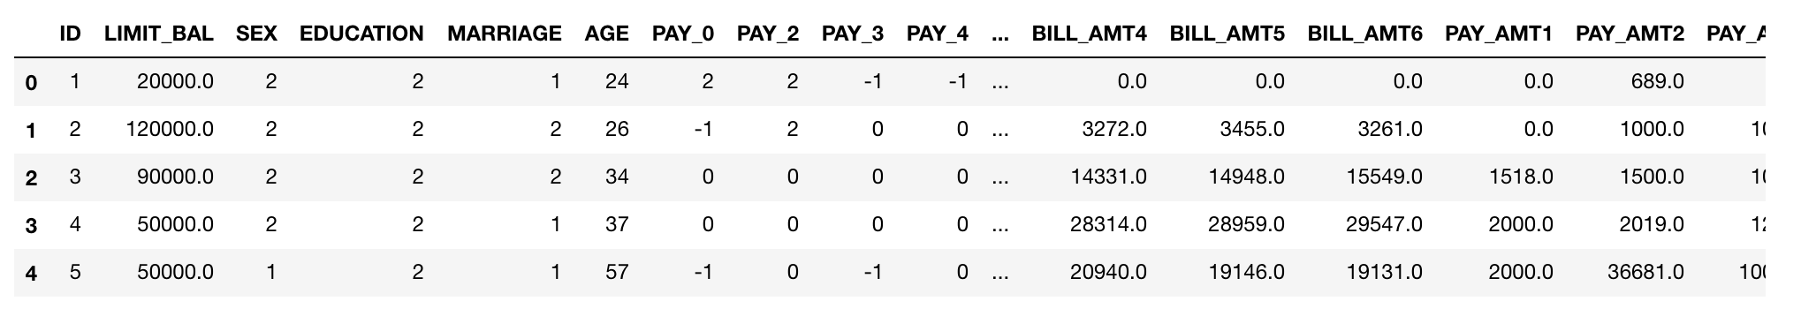
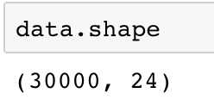
Exploratory Data Analysis
Load the data and observe the 24 variables

Slide 8
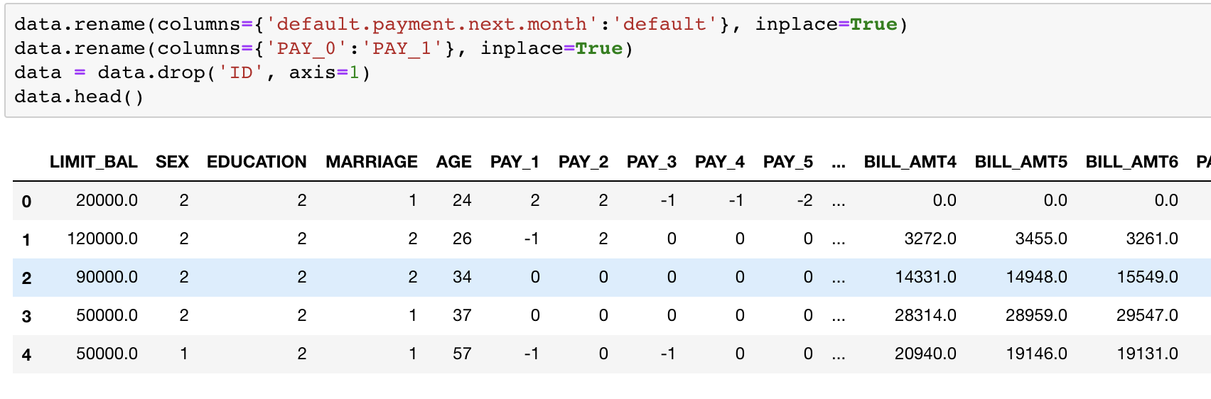
Exploratory Data Analysis
Remove “ID” column and rename two of other confusing columns

Slide 9
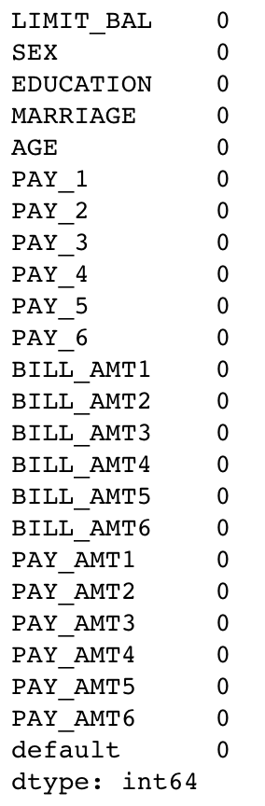
Exploratory Data Analysis
Check the missing values: NO missing values!

Slide 10
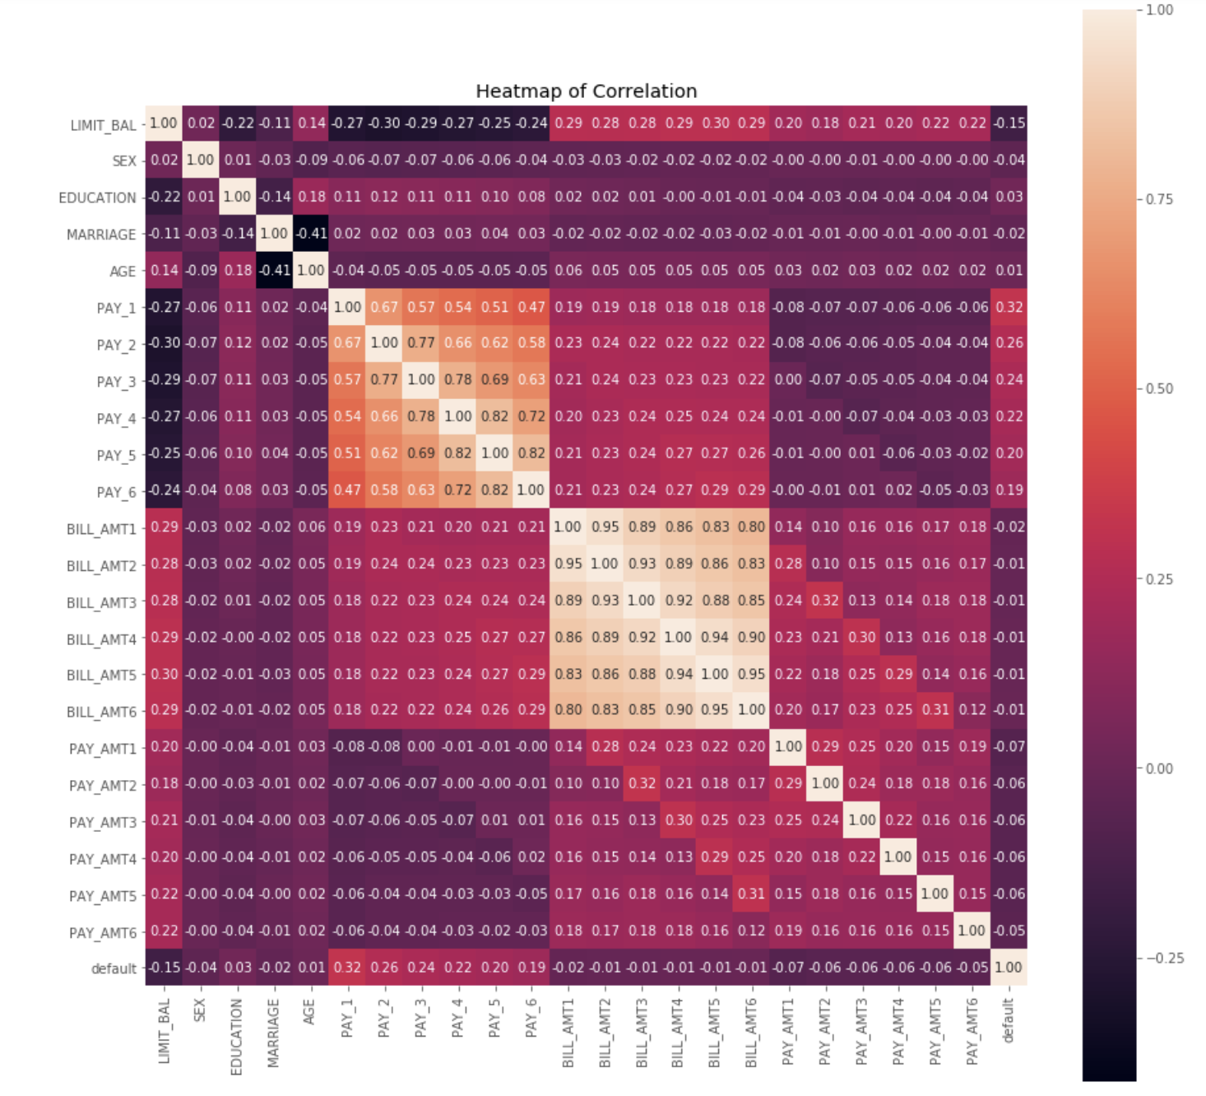
Exploratory Data Analysis
Plot heatmap for correlation among each variable to find out the strongly and weakly correlation between features and default

Slide 11
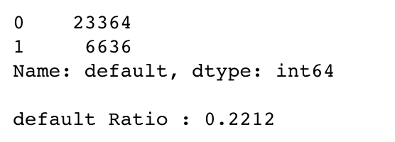
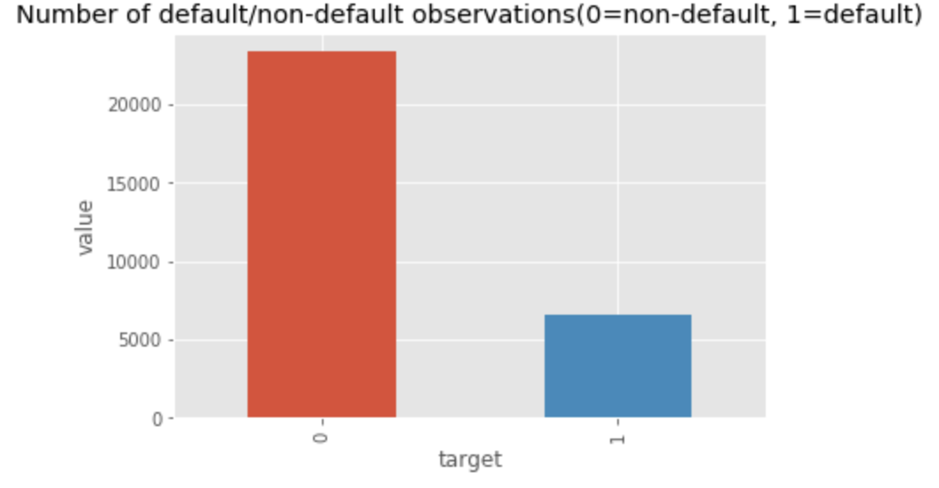
Exploratory Data Analysis
Check balance: Imbalanced!
Default ratio is 22.12%
Split dataset
Resampling strategies

Slide 12
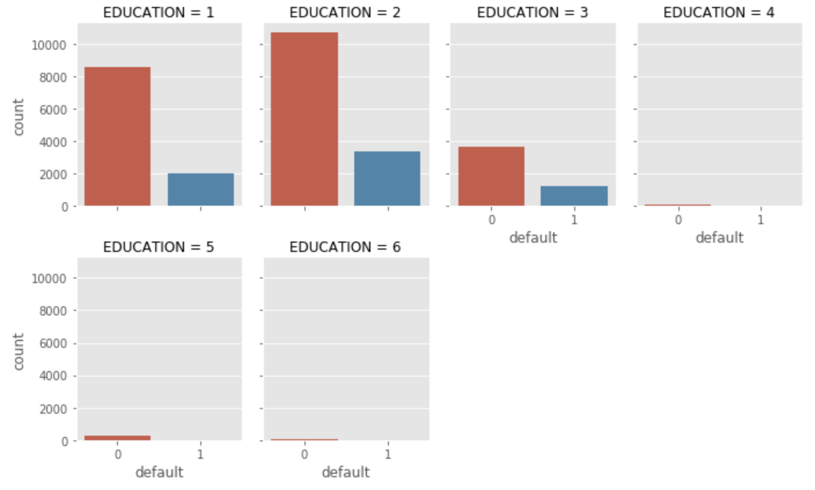
Exploratory Data Analysis
Compare the default to education, however, “education” does not suggest a strong impact to default payment
People who received education from graduate school and university seems have more non-default payments than high school , but not a strong indicator

Slide 13
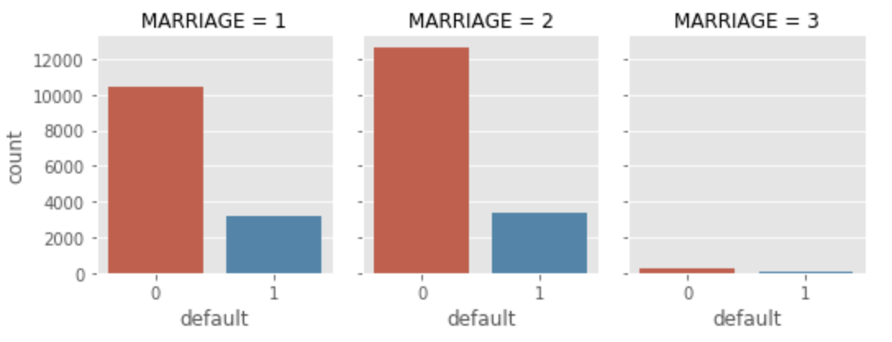
Exploratory Data Analysis
Although people who are single have more non-default payment, it seems not a strong indicator
Hypothesis: people get marriage may affect the default. However, the plot shows it does not really affect

Slide 14
Methodology
Classic Machine Learning: Gaussian Naïve Bayes
Advanced Machine Learning: Multilayers Neural Network via Tensorflow

Slide 15
Machine Learning Model
Gaussian Naïve Bayes from package Sklearn
Normalize the data
Scaling the features to a standard normal distribution with mean of 0 and standard deviation of 1
Fit the model for a good prediction
Process with Gaussian Naïve Bayes

Slide 16
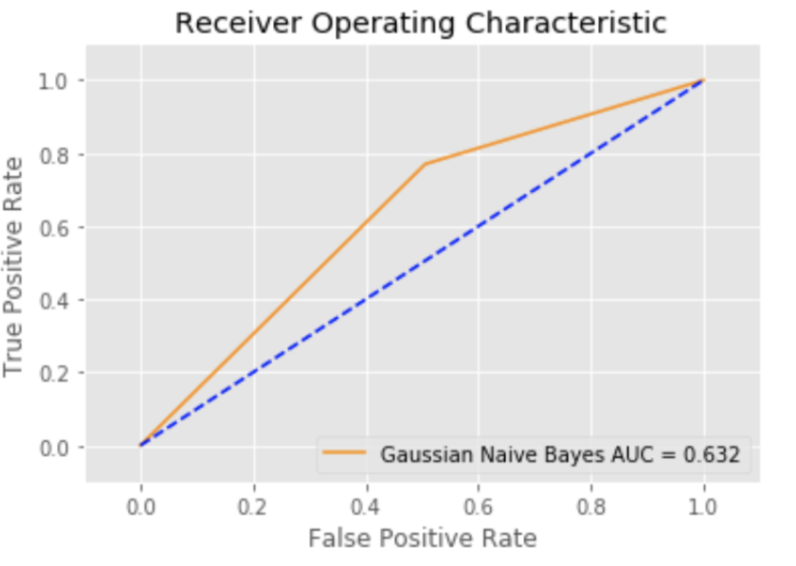
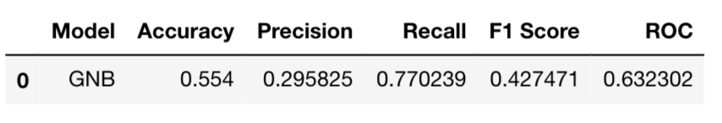
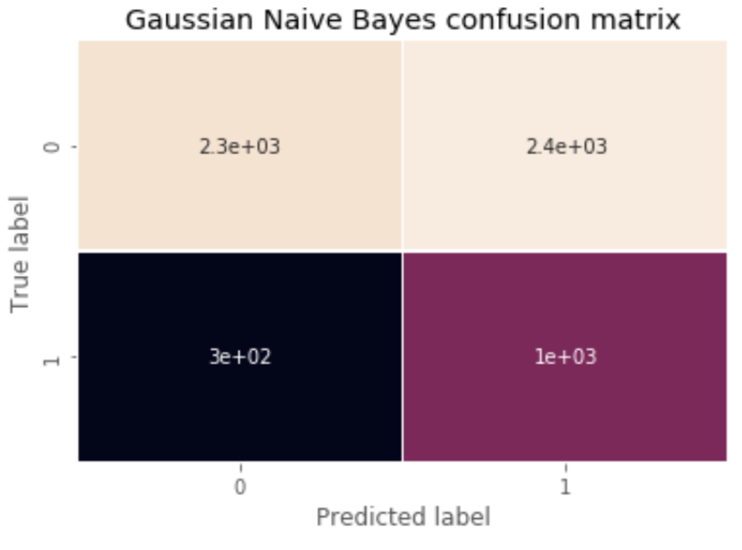
Gaussian Naïve Bayes
Created a table
Accuracy is low as 55.4%
Confusion matrix shows accuracy of predicting non-default is low

Slide 17
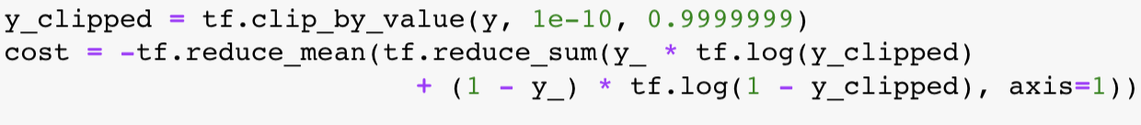
Deep Learning Model
Neural Network with 5 hidden layers via Tensorflow
Scaling the features to a standard normal distribution with mean of 0 and standard deviation of 1 as well
Split the test data to test and validation
Declare the basic structure of the data
Define cost function and optimizer
Start training circle and display logs every 10 epochs

Slide 18
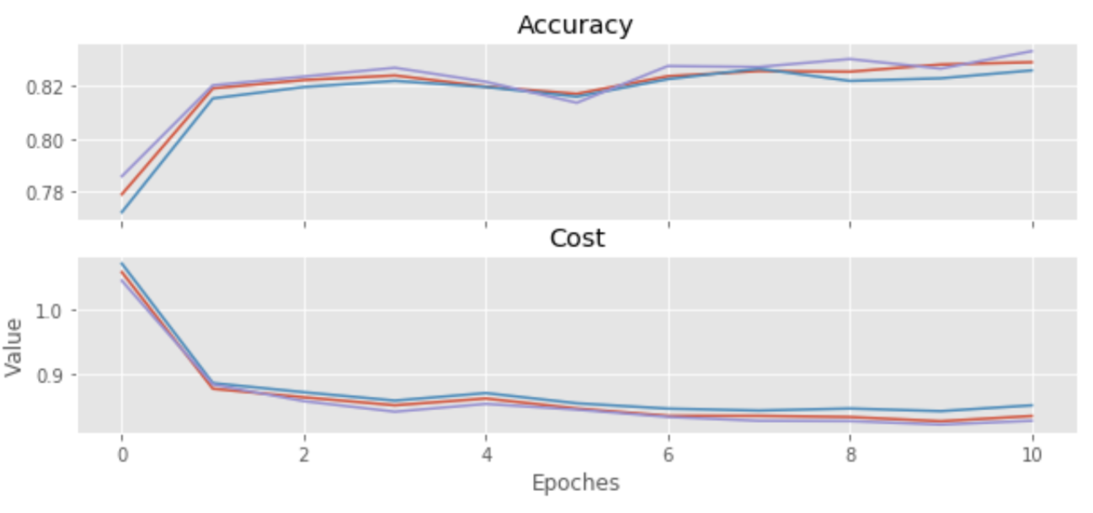
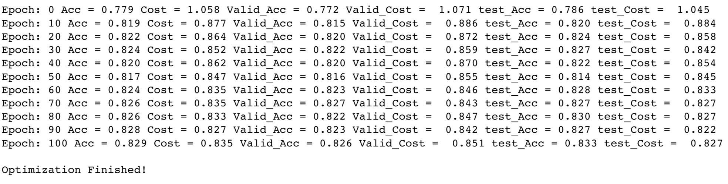
Neural Network
Accuracy is high, the model performs good
With epochs increase, accuracy becomes higher, and cost goes down

Slide 19
Conclusion
Deep learning model – Neural Networks provides a higher accuracy and better performance
Cost becomes lower and accuracy becomes higher when the epochs increased
There are not any extreme demographic variables that indicated the default payment
Further process to make high accuracy in machine learning model : Adaboost, Gradient Boosting

Slide 20
Thank you!

